Slide 1
Mod-2 Stacks
Prepared by
Prof.S.Mahalakshmi
AP/ISE

Slide 2
Topics
Defintion
Stack Operations
Array Representation
Stacks using Dynamic Arrays
Stack Applications
Polish Notation
Infix to Postfix Conversion
Evaluation of Postfix expression

Slide 3
Defintion
A stack is an ordered list in which insertion (push) and deletion (pop) are made at one end called the top.”
The last element inserted is the first element to be deleted, so stack is also called as Last-In-First-Out (LIFO) data structure.
Once the stack is full if we try to insert an element stack overflow occurs.
Once the stack is empty ,if we try to delete an element stack underflow occurs.

Slide 4
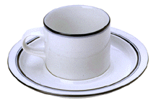
Stack Of Cups
top
F
top
E
E
D
D
C
C
B
B
bottom
bottom
A
A
Add a cup to the stack.
Remove a cup from new stack.
A stack is a LIFO list.
Notes:
Picture is really a stack of cups and saucers.
LIFO = last in first out. The first cup that is removed from a stack of cups is the
Last one that was added to the stack.
Other examples of LIFO lists in real life: stack of trays in a cafeteria; paper stack in a printer or copy machine; newspaper stack at a news stand.

Slide 5
Given a stack S= (a₀, ... ,a_{n-1}), where a₀ is the bottom element, a_{n-1} is the top element, and a_{i} is on top of element ai-1, 0 < i < n.

Slide 6
System stack
A stack used by the program at runtime is called as a system stack.
The system stack is used when functions are invoked and executed.
Note:
When a function is called, a structure called an activation record is created on top of the stack.
When a function is terminated, the activation record is deleted from the top of the system stack.

Slide 7
Activation Record
An activation record is also called as a stack frame.
It is a structure consisting of various fields to store the local variables (if any), parameters (if any), return addresses and pointer to the previous stack frame

Slide 8
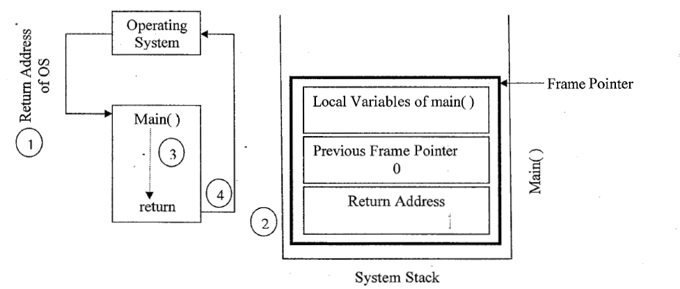
Actions when exe a program

Slide 9
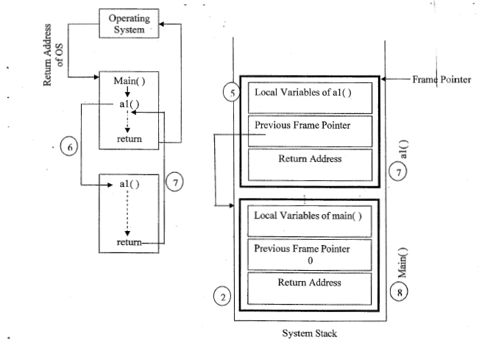

Slide 10
Stack Operations
Insertion (push)
Deletion (Pop)
Display the elements
Check whether the stack is full or not
Check whether the stack is empty or not

Slide 11
ADT Stack
ADT Stack is
Objects: A finite ordered list with zero or more elements
Functions:
For all s € Stack, item € element, stacksize € positive integer.
Stack Create(stacksize) ::=Creates an empty stack whose
maximum size is stacksize
Boolean IsFull(s, stacksize) :=if number of elements in stacks is stacksize
return TRUE
else return FALSE
Stack Push(s, item) : := if (lsFull( s)) stack is full
else insert item on to the stack s and return
Boolean IsEmpty(s) ::=if no elements are there in stack
return TRUE
else return FALSE
Element Pops::=if (lsEmpty(s)) return
else remove and -return the element at the top of the stack

Slide 12
Stack Representaion
Using Arrays
Using Dynamic Arrays
Using Linked list (Mod-3)

Slide 13
Implementation of Stack Operations using Arrays
1.Stack Create
Stack CreateS(maxStackSize )
#define MAX_STACK_SIZE 100 /* maximum stack size*/
typedef struct
{
int key;
/* other fields */
} element;
element stack[MAX_STACK_SIZE];
int top = -1;

Slide 14
2.Boolean IsEmpty(Stack)::=
top < 0;
3.Boolean IsFull(Stack)::=
top >= MAX_STACK_SIZE-1;
4. POP()
element pop ( )
{ /*delete and return the top element from the stack */
if (top == -1)
return stackEmpty(); /*returns an error key */
return stack[top--];
}

Slide 15
5.Push()
void push(element item)
{ /* add an item to the global stack */
if (top >= MAX_STACK_SIZE-1)
stackFull();
stack[++top] = item;
}
6. stackFull( )
void stackFull()
{
fprintf(stderr, "Stack is full, cannot add element");
exit(EXIT_FAILURE);
}

Slide 16
LAB PROGRAM-3
Design, Develop and Implement a menu driven Program in C for the following operations on STACK of Integers (Array Implementation of Stack with maximum size MAX)
a. Push an Element on to Stack
b. Pop an Element from Stack
c. Demonstrate how Stack can be used to check Palindrome
d.Demonstrate Overflow and Underflow situations on Stack

Slide 17
Test Cases
Push
Stack Full
pop
Stack Empty
Palindrome
Not palindrome

Slide 18
Array implementation of stack
#include<stdio.h>
#include<stdlib.h>
#define MAX 5
int Stack[MAX], top=-1;
void push()
{
int ele;
if(top<MAX-1)
{
printf("Enter the value to be inserted into the stack :");
scanf("%d",&ele);
Stack[++top] = ele;
}
else
printf("Stack is Full"); // overflow condition
return;
}

Slide 19
void Palindrome()
{
int i=0, len=top,flag=0;
int stack1[5];
while(top!=-1)
{
stack1[i]=Stack[top--];
i++;
}
for (i = 0; i < len; i++)
{
if (stack1[i] != Stack[i])
{ flag=1;
break;
}
}
if(flag==0)
printf("It is a Palindrome \n");
else
printf("It is not a palindrome");
}

Slide 20
STACKS USING DYNAMIC ARRAYS
The size of bound is impossible to alter during compilation
this can be overcome by using dynamically allocated array for the elements and then increasing the size of array as needed.
with the concept of array doubling

Slide 21
#include<stdio .h>
int capacity = 5;
int *s;
I I function to insert an element into the stack
void push(int item, int *top)
{
if(* top = = capacity -1)
{
I I When stack is full double the size using realloc function
s = (int *) realloc(s, 2 * capacity * sizeof(int));
capacity = capacity * 2;
*top= *top+ 1;
s[*top] =item;
}

Slide 22
I I function to delete an element from the stack
int pop(int *top) ·
{
int item;
if(*top = = -1)
{
return -1;
}
item= s[*top];
*top= *top- 1;
return( item);
}

Slide 23
II function to display the contents of a stack
void display(int top)
{
int i;
if(top = = -1)
{
printf("Stack is empty\n");
return;
}
printf("Contents of the stack are\n");
for(i = 0; i< =top; i++)
{
printf("%d\n", s[i]);
}
}

Slide 24
void main()
{
int top, choice, item, y;
top= -1;
s = (int *)malloc(capacity*sizeof (int));
for(;;)
{
printf("l.Push 2.Pop 3.Display 4. Exit\n ");
printf("Enter your choice\n");
scanf("%d", &choice);
switch( choice)
{
case 1:
printf("Enter element to insert\n");
scanf("%d", &item};
push( item, &top);
break;
case 2:
y = pop(&top);
if(y = = -1)
Printf ("Stack underflow\n");
else
printf("item deleted= %d\n", y);
break;
case 3: display( top);
break;
case 4: free(s);
exit(0);
}
}
}

Slide 25
Stack Applications
Expressions: It is sequence of operators and operands that reduces to a single value after evaluation is called an expression.
X = a / b – c + d * e – a * c
In above expression contains
operators (+, –, /, *) operands (a, b, c, d, e).
Expression can be represented in in different format such as
Prefix Expression or Polish notation
Infix Expression
Postfix Expression or Reverse Polish notation

Slide 26
Infix Expression: In this expression, the binary operator is placed in-between the operand. The expression can be parenthesized or un- parenthesized.
Example: A + B
Here, A & B are operands and + is operand
Prefix or Polish Expression: In this expression, the operator appears before its operand.
Example: + A B
Here, A & B are operands and + is operand
Postfix or Reverse Polish Expression: In this expression, the operator appears after its operand.
Example: A B +
Here, A & B are operands and + is operand

Slide 27
The first problem with understanding the meaning of expressions and statements is finding out the order in which the operations are performed.
Example: assume that a =4, b =c =2, d =e =3 in below expression
X = a / b – c + d * e – a * c
((4/2)-2) + (3*3)-(4*2)
=0+9-8
=1

Slide 28
assume that a =4, b =c =2, d =e =3 in the following expressing
X= ((a / ( b – c + d ) ) * ( e – a ) * c

Slide 29
INFIX TO POSTFIX CONVERSION
An algorithm to convert infix to a postfix expression as follows:
1. Fully parenthesize the expression.
2. Move all binary operators so that they replace their corresponding right parentheses.
3. Delete all parentheses.
Example: Infix expression: a/b -c +d*e -a*c
Fully parenthesized : ((((a/b)-c) + (d*e))-a*c))
: a b / c – d e * + a c *

Slide 30
Algorithm
POLISH(Q,P)
Suppose Q is an arithmetic expression written in infix notation. This algorithm finds the equivalent postfix expression P.
Push “(“ on to the stack and add “)” to the end of Q
Scan Q from left to right and repeat steps 3 to 6 for each element of Q until the STACK is empty.
If an operand is encountered, add it to P
If a left parenthesis is encountered, Push it onto the stack
If an operator is encountered, then
Repeatedly pop from STACK and add to P each operator which has the same precedence as or higher precedence than
Add to STACK
[End of If structure]
X
X
X

Slide 31
6. If a right paranthesis is encountered, then:
Repeatedly pop from STACK and add to P each operator until the left parenthesis is encountered.
Remove left parenthesis.[Do not add ( to P]
[End of If structure]
[End of Step 2 loop]
7. Exit

Slide 32
Infix to postfix conversion
#define SIZE 50 /* Size of Stack */
#include <ctype.h>
#include <stdio.h>
char s[SIZE];
int top = -1; /* Global declarations */
void push(char elem) /* Function for PUSH operation */
{
s[++top] = elem;
}
char pop() /* Function for POP operation */
{
return (s[top--]);
}

Slide 33
int pr(char elem) /* Function for precedence */
{
switch (elem)
{
case '#':
return 0;
case '(':
return 1;
case '+':
case '-':
return 2;
case '*':
case '/':
return 3;
}
}

Slide 34
void main() /* Main Program */
{
char infx[50], pofx[50], ch, elem;
int i = 0, k = 0;
printf("\n\nRead the Infix Expression ? ");
scanf("%s", infx);
push('#');
while ((ch = infx[i++]) != '\0')
{
if (ch == '(')
push(ch);
else if (isalnum(ch))
pofx[k++] = ch;
else if (ch == ')')
{
while (s[top] != '(')
pofx[k++] = pop();
elem = pop(); /* Remove ( */
}

Slide 35
else /* Operator */
{
while (pr(s[top]) >= pr(ch))
pofx[k++] = pop();
push(ch);
}
} // end of while
while (s[top] != '#') /* Pop from stack till empty */
pofx[k++] = pop();
pofx[k] = '\0'; /* Make pofx as valid string */
printf("\n\nGiven Infix Expn: %s Postfix Expn: %s\n", infx, pofx);
} // end of main
Output
Enter the expression :: (a+b)*c+(d-a)
ab+c*da-+

Slide 36
Problem of Evaluating Infix Expression
Infix requires repeated scanning from left to right and right to left because arithmetic operations have to be performed based on precedence of operations.
If there are parenthesis the problem becomes quite complex because parenthesis change the order of precedence.
Adv of POSTFIX/PREFIX conversion
operator and operands define correctly the order of operations.
Since no parenthesis is present, there is no repeated scanning and time taken is less.

Slide 37
Alg for Evaluation of Postfix Exp
Step 1: Scan from left to right till we get an
operator.
Step 2: 0btain immediate 2 left operands.
Step 3: Perform the indicated operation.
Step 4: Replace the operands and the operators
by the result.
Step 5: Repeat through Step 1 till the end of
input

Slide 38
#include<stdio.h>
#include<string.h>
#include<stdlib.h>
#include<math.h>
#define MAX 50
int stack[MAX];
char post[MAX];
int top=-1;
void pushstack(int tmp);
void calculator(char c);
void main()
{
int i;
printf("Insert a postfix notation :: ");
scanf("%s",post);

Slide 39
for(i=0;i<strlen(post);i++)
{
if(post[i]>='0' && post[i]<='9')
{
pushstack(i);
}
if(post[i]=='+' || post[i]=='-' || post[i]=='*' || post[i]=='/' ||
post[i] =='^')
{
calculator(post[i]);
}
}
printf("\n\nResult :: %d",stack[top]);
}

Slide 40
switch(c)
{
case '+':
ans=b+a;
break;
case '-':
ans=b-a;
break;
case '*':
ans=b*a;
break;
case '/':
ans=b/a;
break;
case '^':
ans=pow(b,a);
break;
default: ans=0;
}
void pushstack(int tmp)
{
top++;
stack[top]=(int)(post[tmp]-48);
}
void calculator(char c)
{
int a,b,ans;
b=stack[top];
stack[top]='\0';
top--;
a=stack[top];
stack[top]='\0';
top--;

Slide 41
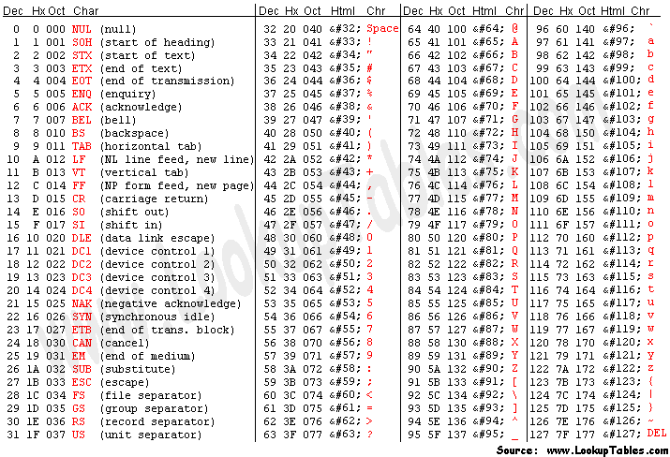
ASCII table

